Slide 1

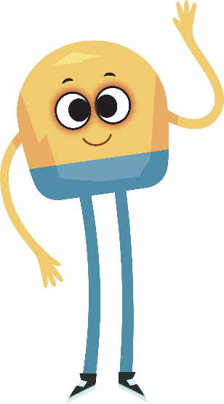

Unit 3: Week 6
Kindergarten

Slide 2
Copyright © Savvas Learning Company LLC. All Rights Reserved.
This publication is protected by copyright, and permission should be obtained from the publisher prior to any prohibited reproduction, storage in a retrieval system, or transmission in any form or by any means, electronic, mechanical, photocopying, recording, or otherwise. For information regarding permissions, request forms, and the appropriate contacts within the Savvas Learning Company Rights Management group, please send your query to:
Savvas Learning Company LLC, 15 East Midland Avenue, Paramus, NJ 07652
or
k12learningpermissions@savvas.com
myView Literacy® is an exclusive trademark of Savvas Learning Company LLC in the U.S. and/or other countries.

Slide 3

Lesson 1

Slide 4
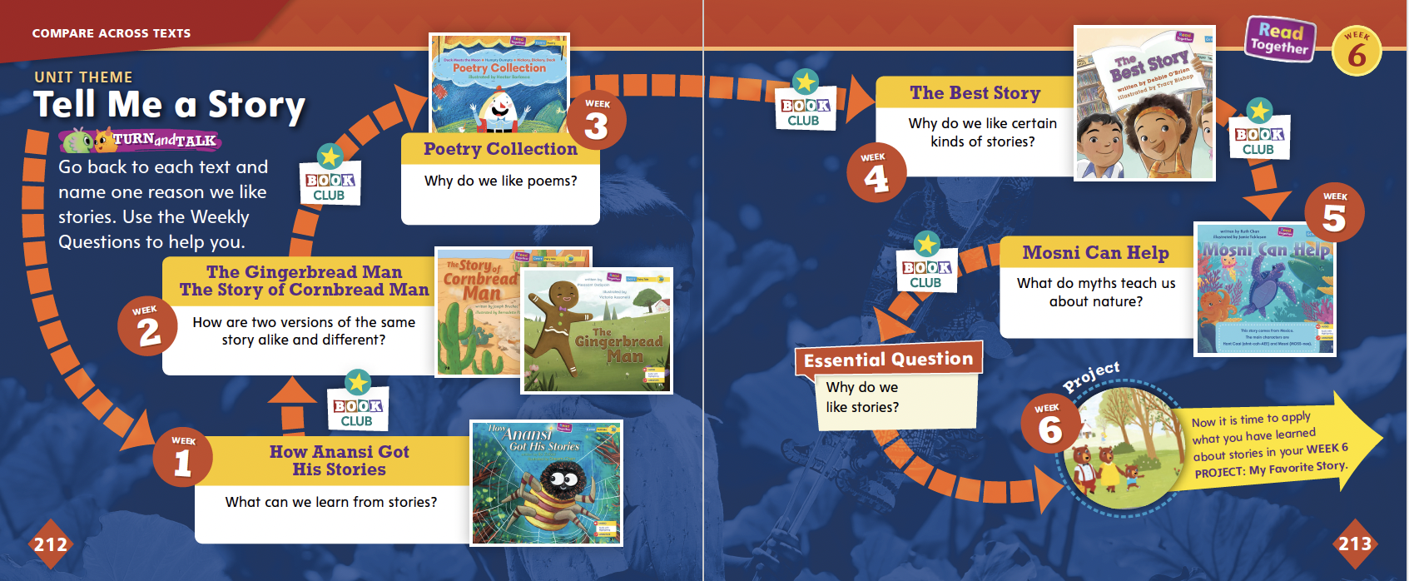
Page
212, 213
Compare Across Texts
Go back to each text and name one reason we like stories.
Notes:
Remind students of the unit theme, Tell Me a Story, and the Essential Question: Why do we like stories? Tell students they will be researching and reading different stories this week. They will decide on a story they like and write or draw about why others should read that story.
Pair students and have them find sentences or pictures from each text they read in the unit. Tell them to think about what makes each story special and to tell one reason why they like stories as they look at each text. They can use the Weekly Questions to help them.

Slide 5

Page
212, 213
Compare Across Texts
Why do we like stories?
Write or draw your answer.
Notes:
Remind students that all of the selections they have read in this unit are connected by the theme, Tell Me a Story. Then use the questions below to help them compare texts.
How are How Anansi Got His Stories and Mosni Can Help similar? (Possible response: They are similar because both have characters that solve problems.)
Which version of the story did you like better, The Gingerbread Man or The Story of Cornbread Man? Why? (Answers will vary, but encourage students to explain their thoughts with reasons.)
In The Best Story, students like to pretend to be the characters. What characters from any of this unit’s stories would you like to pretend to be? Why? (Answers will vary, but encourage students to explain their thoughts with reasons.)
Have students write or draw their responses to the Essential Question: Why do we like stories?

Slide 6


Phonological Awareness
Notes:
Tell students that today they will review the sound /u/. Remind them that the sound /u/ is made by opening your mouth slightly and saying the sound /u/. Show students how to make the sound /u/ and have them practice it.
Display the jug Picture Card. This is a picture of a jug. Listen to the sounds in jug: /j/ /u/ /g/. What sound do you hear in the middle of jug? Students should tell you /u/.
Then hold up the tub Picture Card. This is a picture of a tub. What sound do you hear in the middle of /t/ /u/ /b/, tub? (/u/) What other words can you think of that have the sound /u/ in the middle like jug and tub? Possible responses are hug, bug, rub, cub, and mug. Click path -> Table of Contents -> Unit 3 Week 6 Project-Based Inquiry-> Lesson 1

Slide 7

Phonics
nut
cut
rut
hut
run
bun
sun
fun
Notes:
Display Alphabet Card Uu and point to the picture of the umbrella. What sound do you hear at the beginning of umbrella? Students should identify the sound /u/. We already learned which letter spells the sound /u/. What letter is it? Point to the letters Uu. Students should say u. Click path -> Table of Contents -> Unit 3 Week 6 Project-Based Inquiry-> Lesson 1
Write the word nut on the board. Point to each letter as you say the sound: /n/ /u/ /t/. Notice how each letter makes a different sound. When I blend the sounds of the letters n, u, t together, I read the word nut. Say the sounds with me: /n/ /u/ /t/
Model blending the word together. Then write the words cut, rut, hut, run, bun, sun, fun, and pun on the board. Repeat the blending routine by identifying the sounds, identifying the letters that spell the sounds, and reading the words with students.
Have partners take turns reading the words on the board.

Slide 8
High-Frequency Words
going
know
live
Notes:
Write the high-frequency words going, know, and live on the board.
Show students familiar letter sounds in these words, such as the sound /g/ spelled g, and the sound /l/ spelled l.
Point to the word going and read it.
Have students identify the word going by pointing to it. Then have them read the word.
Repeat for know and live.

Slide 9
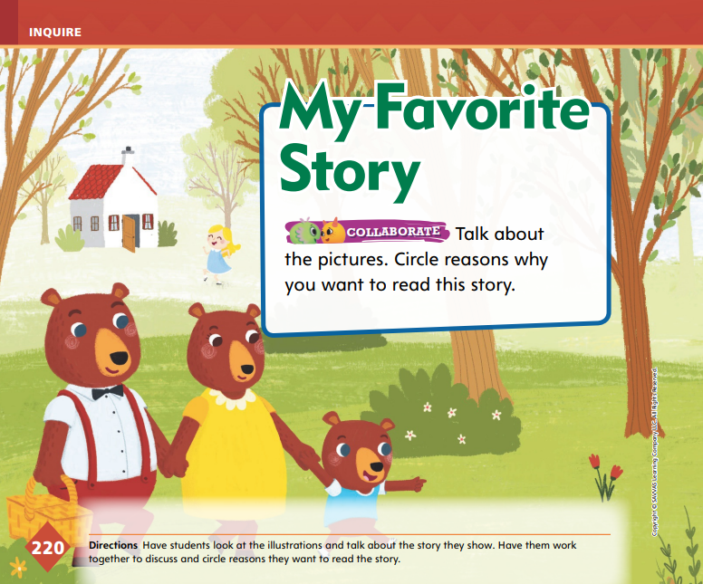

Page
220
Inquire – Introduce the Project
Think about your favorite story.
Share your ideas with a partner and talk about how you can find out more about your story.
Notes:
Explain to students that this week they will work on making a research plan to do a project about their favorite story.
Then they will write a persuasive text that will make others want to read their favorite story. Remind students that a research plan tells all the steps needed to complete a research project.
Say: Think about your favorite story. Then think about how you can find out more about your story. Where do we go for research? After students have a discussion about where to conduct research and what they may need to plan their projects, put them in pairs.
Use these questions to help students begin thinking about their favorite stories and research plans: What do you like about your favorite story? How can you learn more about your story? What steps do you think are in a research plan?

Slide 10

Page
220
Inquire – Introduce the Project
Talk about why you would want to read this story.
Circle reasons why you want to read this story.
Notes:
Have student pairs look at the pictures on p. 220 in the Student Interactive and use the pictures to talk about why they would want to read this story.
Have them circle reasons why they want to read this story.
Check in with students as they develop their ideas about a research plan. Help students understand that this plan should include choosing a topic, asking questions about it, and finding answers to these questions.
For Differentiated Support:
If students struggle with talking about the story and circling reasons, guide them with sentence starters. For example, say: This picture makes me think of _____ . The reason I like this story is that _____ .
If students complete the activities with ease, suggest that they add pop-up pieces to p. 220 in the Student Interactive by cutting out a piece of paper to place over the picture. On the outside of the pop-up piece, have them write the Academic Vocabulary word they believe fits with that picture. Then they can share their ideas with a partner.

Slide 11
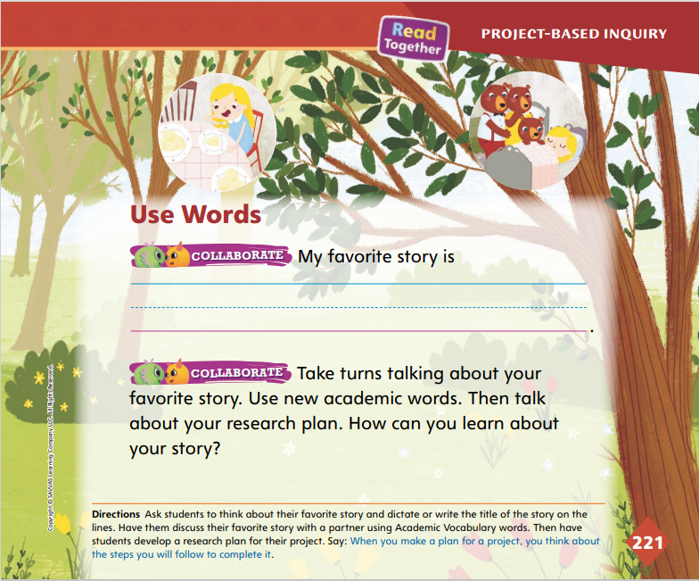
Page
221
Inquire – Academic Vocabulary
Turn to page 221 in your Student Interactive.
Talk about your story and your research plan using your Academic Vocabulary.
Notes:
Remind students of the Academic Vocabulary words, choose, explain, meaning, and character.
Have students use these words in sentences about their story and their research plan.
Tell students that they will begin to research their favorite stories and follow the research plans they developed. Explain that even though they may have worded their plans differently from their classmates, most first steps include choosing a topic. In this case, they chose a favorite story, so this step is complete. In the next step, they do research

Slide 12
Lesson 2

Slide 13


Page 214
Phonics
-ug | -un
rug
bug
sun
fun
Notes:
Remind students that a word family is a group of words that have the same ending sounds spelled the same way. Hold up the rug Picture Card. This is a picture of a rug. The beginning sound in rug is /r/. The ending part in rug is /u/ /g/ spelled –ug. Click path -> Table of Contents -> Unit 3 Week 6 Project-Based Inquiry-> Lesson 2
Write the word rug on the board. Underline the onset with one color and the rime with another color. Then write the word bug. Have students read the word and tell you if the word bug belongs in the same word family as rug. Repeat the activity with lug, lag, tug, and mug.
Hold up the sun Picture Card. This is a picture of the sun. The beginning sound in sun is /s/. The ending part in sun is /u/ /n/ spelled -un.
Write sun on the board. Under sun, write the word fun. Have students read the word and tell you if it belongs in the same word family as sun. Repeat the activity with bun, pun, rip, and run.
Write the headings -ug and -un on the board. Tell students that you will say a group of words either in the -un or -ug word family. Tell them to listen carefully to the words. Remind them that there will be one word in each group that is not part of the -ug or -un word family. Tell students to listen carefully. Use the following words for this activity: mug, sit, rug; sun, ham, run; lug, tug, bet; fun, bun, and lit.

Slide 14
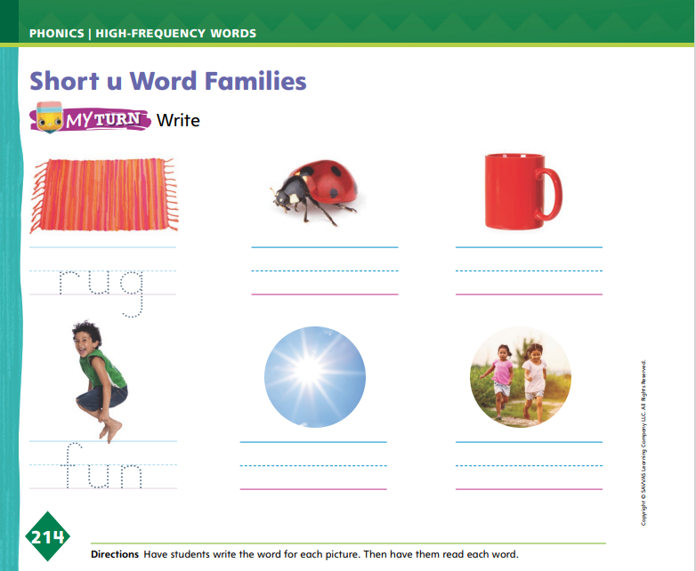
Page 214
Apply
Turn to page 214 in your Student Interactive and write the words on the line.
Notes:
Have students identify each picture on p. 214 in the Student Interactive, and then have them write the words on the lines.

Slide 15
High-Frequency Words
going
know
live
Notes:
Tell students that high frequency words are words that they will hear and see over and over in texts.
Write and then read the words going, know, and live.
Have students read the words with you.
Have students clap each letter as they spell the words.

Slide 16
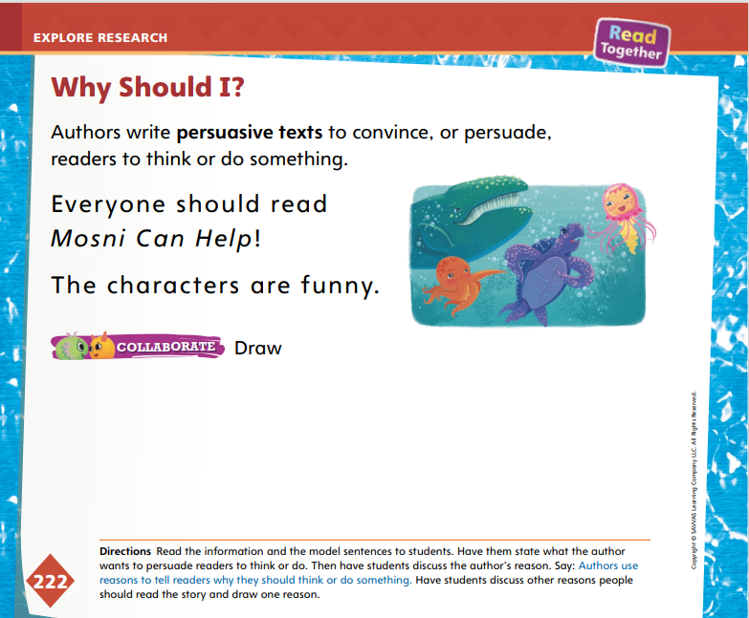
Page 222
Explore and Plan – Persuasive Writing
Turn to page 222 in your Student Interactive.
Notes:
Introduce persuasive text by saying that for a reader, a persuasive text answers the question, Why should I?
Have students turn to p. 222 in the Student Interactive. Remind students that they wrote a persuasive text when they wrote about why they liked art museums or history museums in Unit 1. Explain that now they will write a persuasive text about why they like their favorite story.
Say: Persuasive writing tries to make someone agree with you. With this kind of writing, authors start by telling an opinion. An opinion is how you feel about something. Writers then give facts or reasons to give power to their opinions. Look at the picture on p. 222 while I read the sentence. What do you think the author wants you to do? What is a good reason people should do this?

Slide 17
Page 222
Apply
Turn to page 222 in your Student Interactive and complete the activity with a partner.
Notes:
After the class discussion, have students complete the activity on p. 222 by instructing them to discuss the story Mosni Can Help with a partner and then draw one reason someone should read this story.
Remind students that they will research their stories at the library. Tell students that they will learn how to find information so that they can write their persuasive texts.
Explain that when they write a persuasive text and share their ideas, their classmates will be the audience. In order to make their classmates agree with their opinions about a story, encourage students to think about these questions: Why do I really like this story? What would my classmates like about this story? What words can I use to make them want to read this story?

Slide 18
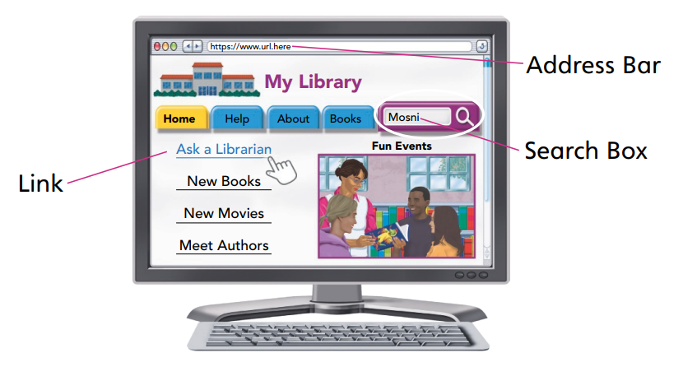
Page 223
Conduct Research
Point to the things on a computer screen that are shown in the picture.
Notes:
Explain that libraries have something called a database. A database is a way to find books and other sources. Explain that students will use the library database to find their favorite stories. Direct them to p. 223 in the Student Interactive. Use the Model and Practice to explain how to use a library database and recognize multimedia texts.
Say: We will use the library database to find our stories. We can use the database on computers at the library. Before we do that, let’s practice with the activity on page 223 in the Student Interactive. Everyone take one finger and point to the things on a computer screen that are shown in the picture.
Explain that a Web site is a multimedia text because information is presented in many ways, including words and pictures. Then call out address bar, search box, and link. As you point, give a definition of each. Say: An address bar tells us where we are on the Internet. In this case, we are on our library’s home page. A link is something to click the mouse on. This will lead us to another page. These pages give us more information. The search box is the place where we type in what we want to know about. We want to type in the titles of our stories so we can find them in our library. Once our stories come up on the screen, we can find them in the library. We get a special number called a call number. This tells us exactly where books are on the shelves. Now that you know a little about our library database, work on the activity on page 223. Circle the place on the library Web page where you will type in the name of your story to search for it.

Slide 19
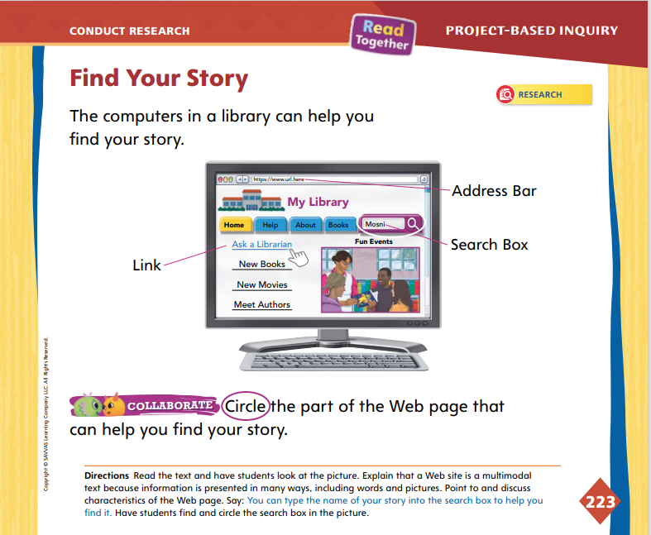
Page 223
Conduct Research
Turn to page 223 in your Student Interactive.
Work with your partner to find your story.
Take notes on your story.
Notes:
Have students complete the activity on p. 223 in the Student Interactive. Then have them work in pairs to find their stories.
For differentiated support:
If students struggle with the computer and using the database, spend extra time explaining the features of a Web page.
If students easily navigate the Web page and library database, pair them with other students who may have difficulty, allowing them to model and explain.
When students have completed p. 223 in the Student Interactive and collected their stories from the library, explain that the next step is to take notes on their stories. Remind them of the research plans they came up with on the first day.

Slide 20
Lesson 3

Slide 21
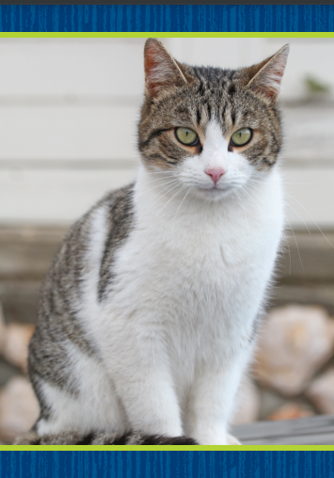
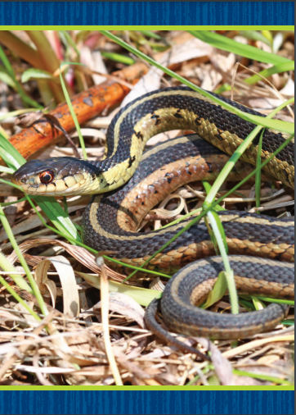
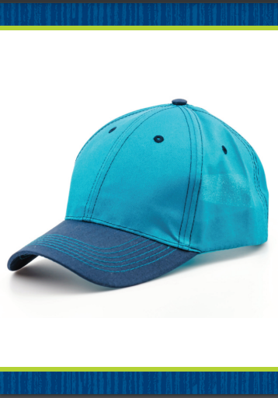
Phonological Awareness
Notes:
Tell students that today they will review the sounds /a/ and /ā/. Display the cat Picture Card. Point to the picture of the cat and tell students the word cat has the middle sound /a/.
Hold up the snake Picture Card. Point to the picture of the snake and tell students the word snake has the middle sound /ā/. Have students repeat the sounds /a/ and /ā/ after you.
Display the cap Picture Card. Do you hear the sound /a/ or the sound /ā/ in the middle of cap? Students should say /a/. Say the word cape. Do you hear the sound /a/ or the sound /ā/ in the word cape? Students should say /ā/. Click path -> Table of Contents -> Unit 3 Week 6 Project-Based Inquiry-> Lesson 3
Divide the class into two teams: /a/ and /ā/. When you say a word with the sound /a/, the /a/ team cheers. When you say a word with the sound /ā/, the /ā/ team cheers. Use these words: rat, rake, make, map, can, cane.

Slide 22
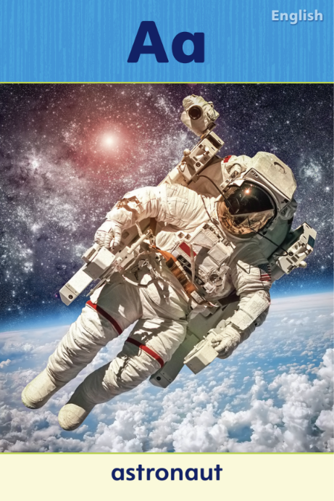
Phonics
cat
mat
tape
lap
lake
name
Notes:
Display Alphabet Card Aa and point to the picture of the ant. Click path -> Table of Contents -> Unit 3 Week 6 Project-Based Inquiry-> Lesson 3
What sound do you hear at the beginning of ant? Students should identify the sound /a/. We already learned about the letter that spells the sound /a/. What letter is it?
Point to the letters Aa. Students should say a. Repeat the routine with the snake Picture Card to review the a_e spelling for the sound /ā/.
Write the word cat on the board. Point to each letter as you say the sound: /k/ /a/ /t/. When I blend the sounds of these letters together, I read the word cat. Say the letter sounds with me: /k/ /a/ /t/. Model blending the word together.
Then write the words mat, tape, lap, lake, and name on the board, and repeat the blending routine by identifying the short or long a and reading the words with students.
Have partners take turns reading the words on the board.

Slide 23
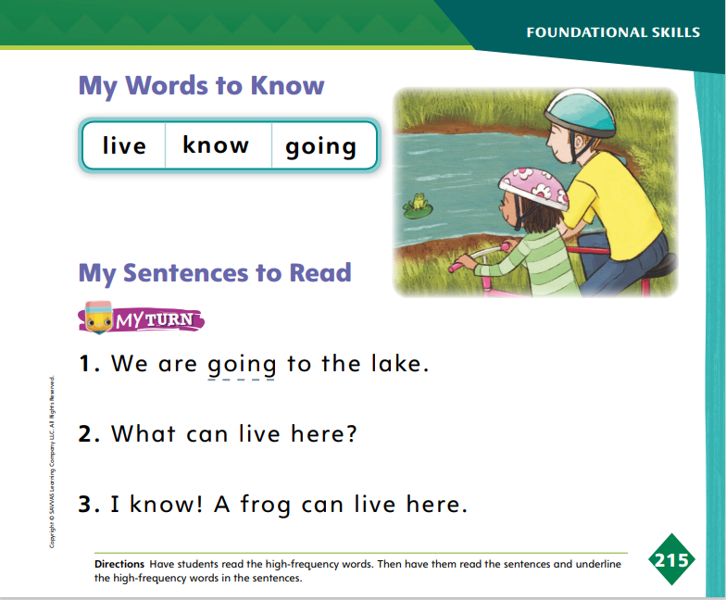
Page 215
High-Frequency Words
Turn to page 215 in your Student Interactive and complete the activity.
Notes:
Tell students that today they are going to continue working with this week’s high-frequency words. Have students read the words at the top of p. 215 in the Student Interactive with you: live, know, going.
Have students look at the words at the top of p. 215. Tell them to identify and point to each word when you say it. Say going. Pause to let students find and point to the word. Say know. Say live. Repeat the activity until students are familiar with each word. Encourage students to use the words in sentences.
Have students read the sentences on p. 215 with you. Ask them to identify the words live, know, and going in the sentences. Have them underline the high-frequency words in the sentences. Then have students read the sentences with a partner.

Slide 24
Page 224
Collaborate and Discuss
Characters
Beginning
Middle
End
Notes:
Taking notes will help students think about their stories in a new way. This will help them tell others why they should read their stories. Explain to students that they can organize their notes in a graphic organizer called a story map.
Draw a story map on the board. This has a box at the top with the word Characters. Below that box are three boxes linked with flow chart arrows. The three boxes are labeled, Beginning, Middle, and End. Say: This is called a story map. You can take notes about your stories by thinking of these parts of a story.
Point to the Characters box. I will draw a picture of the main character in my story. The main character is the one who does the most action and has the most thoughts.
Point to the Beginning, Middle, and End boxes. Guide students through a sample story sequence, such as Mosni Can Help. Ask the whole class to recall the story. As students give examples of what happens at each stage of the story, draw a picture to show their points.
Direct students to p. 224 in the Student Interactive. Read aloud the sample and discuss why the theme of bravery is a reason people should read the story. Say: This example shows persuasive writing. It gives a reason why people should read Mosni Can Help. When you remember something from your story that fits in the story map, draw it in the place it belongs.
Provide students with story map graphic organizers. Have them look through or reread their stories and take notes.

Slide 25
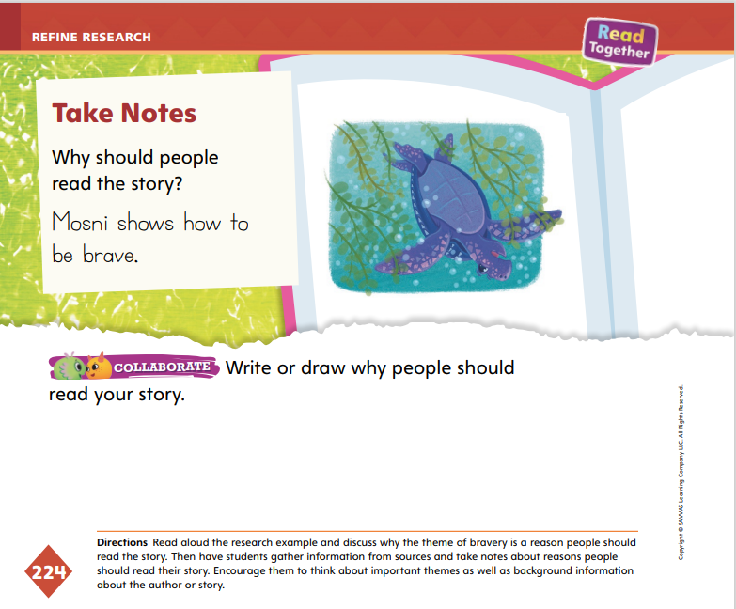
Page 224
Refine Research
Turn to page 224 in your Student Interactive and complete the activity.
Think about what you could add to be more persuasive.
Notes:
After students finish taking notes, have them complete the activity on p. 224.
Have them write or draw why people should read their story. Encourage them to look back at their notes when thinking of reasons.
Ask students why they like certain parts of the story, such as: How does the story make you feel? What is the story about? Why do you like a character? This will guide their persuasive writing or drawing to be about themes or details in the story.
Explain that writers rewrite and change their writing to make it better. Remind students that their persuasive writing will need to make someone want to read their stories. Ask them to think about what could be added to make their persuasive writing better.

Slide 26
Lesson 4

Slide 27
Phonics
-ub
-ut
cub
rut
Say which word family the word belongs to.
Notes:
Tell students that today they will continue working with word families. Write the word cub on the board. This is the word cub. The beginning sound in cub is /k/. The ending part in cub is /u/ /b/ spelled -ub.
Write the heading -ub and the word cub on the board. Have students read the word and tell you if it belongs in the -ub family. Continue the activity with the word rub.
Write the word rut on the board. This is the word rut. The beginning sound in rut is /r/. The ending part in rut is /u/ /t/ spelled -ut.
Write the heading -ut and the word rut on the board. Have students read the word and tell you if it belongs in the -ut family. Continue the activity with the word jut.
Write the headings -ub and -ut on the board. Tell students you will say a group of words either in the -ub or -ut family. Tell them that there will be one word in each group that isn’t in the -ub or -ut family. Use the following words for this activity: rut, pan, cut; tub, cub, sit; nut, hut, leg.

Slide 28
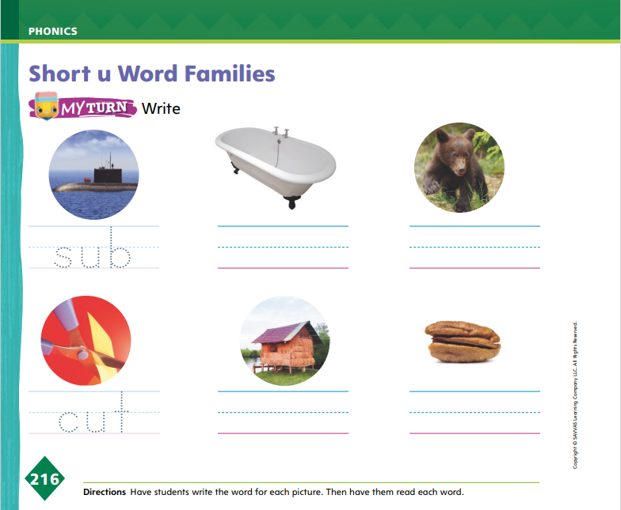
Page 216
Apply
Turn to page 216 in your Student Interactive and complete the activities.
Notes:
Have students identify each picture on p. 216 in the Student Interactive that belongs either to the -ub or -ut word family.
Have them write the words on the lines.

Slide 29
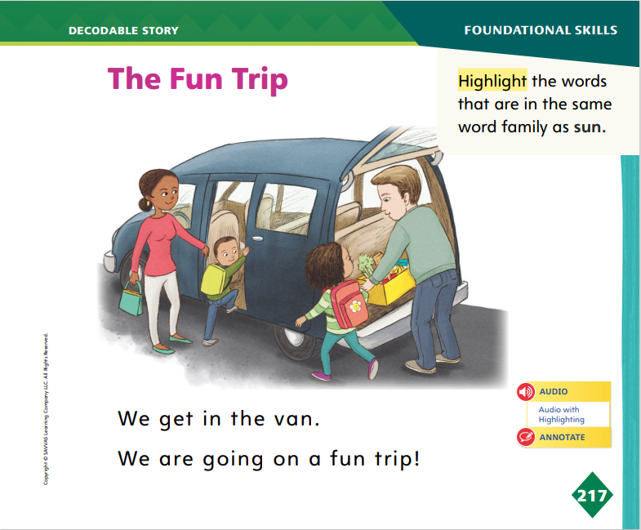
Page 217
Decodable Story
Turn to page 217 in your Student Interactive. Read “The Fun Trip” with your partner.
Notes:
Have students turn to p. 217 in the Student Interactive. We are going to read a story today about a family who goes on a trip.
Point to the title of the story. The title of the story is The Fun Trip. I hear the sound /u/ in the word fun. In this story, we will read other words with the sound /u/ spelled u.
Remind students of this week’s high-frequency words: going, know, live. Tell them that they will practice reading these words in the story The Fun Trip.
Display the words. Have students read them with you. When you see these words in the story The Fun Trip, you will know how to identify and read them.
Have students whisper read the story as you listen in. Then have students reread the story page by page with a partner. Listen carefully as they use letter sound relationships to decode. Partners reread the story. This time the other student begins.
After students have read the story, call their attention to the title. I see the letter u in this word. What sound does the letter u spell? Help them identify, or say, the sound /u/. Then have them locate and highlight the words on p. 217 that belong in the same word family as sun.

Slide 30
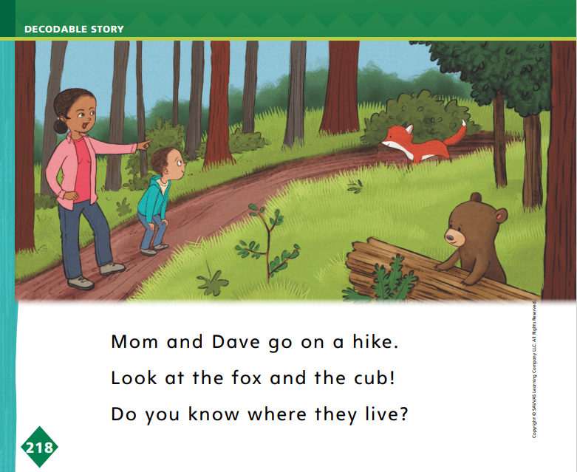
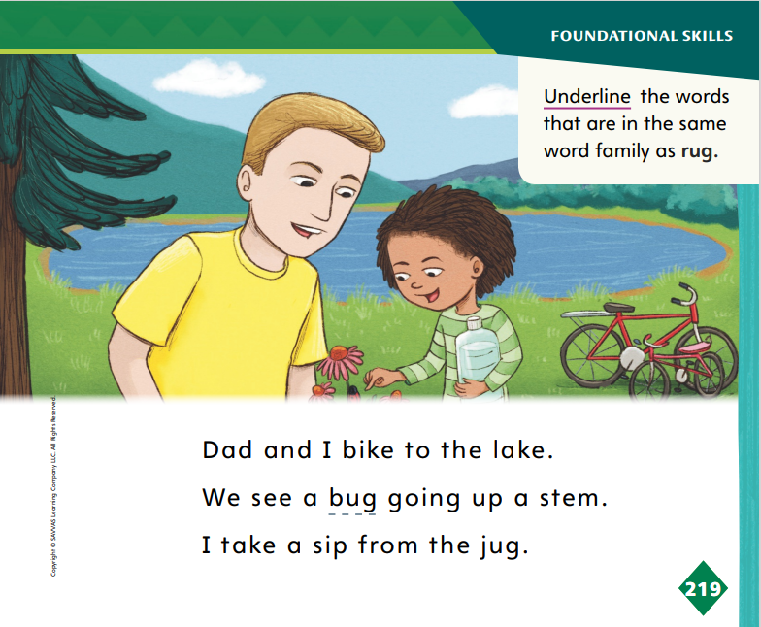
Page 218, 219
Decodable Story
Turn to pages 218-219 in your Student Interactive. Read “The Fun Trip” with your partner.
Notes:
Have students turn to pp. 218–219. Which word is in the same family as rub? Students should supply the word cub.
How do you know cub is in the same family as rub? Students should say that both words end with the same sounds spelled the same way, so they are in the same word family.
Which words are in the same family as rug? Students should supply the words jug and bug. How do you know jug and bug are in the same family as rug? Students should say that the words all end with the same sounds spelled the same way, so they are in the same word family.
Have students underline the words that belong in the same family as rug.

Slide 31
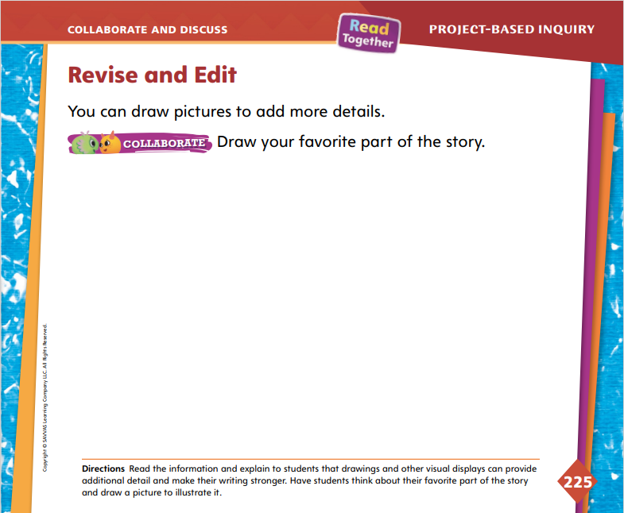
Page 225
Collaborate and Discuss
Turn to page 225 in your Student Interactive.
Notes:
Explain to students that when writers revise their writing, they often add details to make it better. Tell them they will be drawing their favorite part of the story. This will help add detail to make their final copies better. Encourage students to revisit their notes to help them choose events they can add to their stories. Use the Model and Practice to help students.
Direct students’ attention to p. 225 in the Student Interactive. Say: We can make our writing better by adding a drawing. Think about your favorite stories you have researched and written about. What is your favorite part in your story? You can look back at your story map to help you remember the beginning, middle, and end of the story. Once you think of your favorite part, draw a picture of that part of the story. This will be a detail in your persuasive text. A detail adds more to your writing and makes it better. It may make readers want to read the story you are writing about.
Ask guiding questions to help students revise and edit the draft of their persuasive text.
Do I use words or drawings that show why people should read my story?
Do I have another drawing that shows my favorite part of my story?
Is there anything else I can add to make my final copy better?

Slide 32
Page 225
Collaborate and Discuss
Turn to page 225 in your Student Interactive and complete the activity with a partner.
Notes:
Have students review their notes and draw the favorite parts of their stories by completing the activity on p. 225 in the Student Interactive.
For differentiated support:
Have students review their notes on their stories. Ask: What did you draw in the beginning, middle, or end of your story map? Which part do you like best? Why? Record students’ responses and guide them to draw their favorite event in the story.
If students easily draw and tell their favorite event in their stories, have them review their story maps and draw another event. Allow students to write words or sentences to label their drawings.

Slide 33

Apply
Revise and edit your persuasive writing.
Write a clean, final copy of your persuasive writing.
Notes:
Remind students that their audience is their classmates, so they can think about what would make their classmates want to read their stories.
Instruct students to create a final copy on a separate sheet of paper.
Invite students to recall the research plans they created at the beginning of the week. Tell students they have completed the “Revise and Edit” step in the research plan. Remind them that next they will share their persuasive writing with the class.

Slide 34
Lesson 5

Slide 35
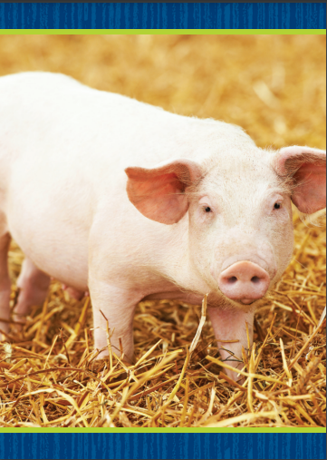

Phonological Awareness
Notes:
Tell students that today they will review the sounds /i/ and /ī/. Display the pig Picture Card. Point to the picture of the pig. Listen to the sounds in this word: /p/ /i/ /g/. Pig has the middle sound /i/. Hold up the five Picture Card. Click path -> Table of Contents -> Unit 3 Week 6 Project-Based Inquiry-> Lesson 5
Point to the picture of the number five. Listen to the sounds in this word: /f/ /ī/ /v/. Five has the middle sound /ī/. Have the students repeat the sound /ī/.
Say the word kit. Listen to the sounds in the word: /k/ /i/ /t/. Do you hear the sound /i/ or the sound /ī/ in the middle of kit? Students should say the sound /i/. Now listen to the sounds in the word kite: /k/ /ī/ /t/. Do you hear the sound /i/ or the sound /ī/ in the word kite? Students should say the sound /ī/.
Divide the class into two teams: /i/ and /ī/. When you say a word with the sound /i/, that team cheers. When you say a word with the sound /ī/, that team cheers. Use these words: rip, ripe, dive, pit, lip, like.

Slide 36

Phonics
jut
hub
gum
mug
hum
cut
sub
mud
pug
Notes:
Tell students that today they will review a letter sound they have already learned. Display the truck Picture Card. Truck has the middle sound /u/. Which letter spells the sound /u/? Turn the card over and point to the letter u in the word truck. Click path -> Table of Contents -> Unit 3 Week 6 Project-Based Inquiry-> Lesson 5
Have students decode words with the sound /u/ spelled u. Write jut on the board. Listen as I read the word jut: /j/ /u/ /t/. The word jut has the middle sound /u/ spelled u: jut.
Display the following words and have students decode them: hub, gum, mug, hum, cut, cub, sub, mud, pug.
Have partners take turns spelling the words jut and sum aloud.

Slide 37
High-Frequency Words
going
know
live
Notes:
Remind students that high frequency words are words that appear over and over in texts.
Say the word going, and ask students what letters spell the word.
Have students say the letters as you write them on the board.
Have students read the words aloud.
Repeat with the words know and live.

Slide 38
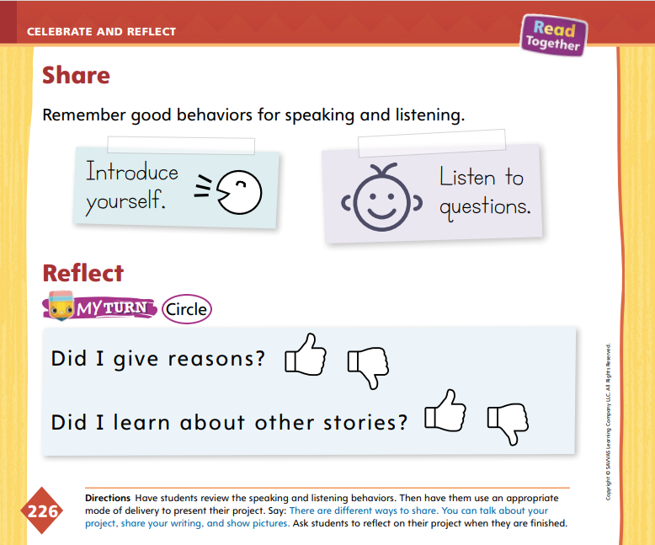
Page 226
Celebrate and Reflect
Turn to page 226 in your Student Interactive.
Present your persuasive writing to your classmates as you follow the rules for speaking and listening.
Notes:
Remind students that they will share their research projects with the class. Explain that their projects will have writing, drawing, or both, and these final copies will be presented. Give students time to choose an appropriate mode of delivery and practice their presentations with their partners.
Direct students to p. 226 in the Student Interactive and go over the good behaviors of speaking and listening:
Introduce yourself.
Listen to questions.
Remind them to practice showing their writing or drawing as they speak. Use the active listening routine to help students be good listeners.
Model the active listening routine to set expectations for audience members.
Look Look at the person who is talking. Do not talk.
Think Think about what the person is saying.
Respond Raise your hand when you have a question. Clap when the speaker is finished.

Slide 39
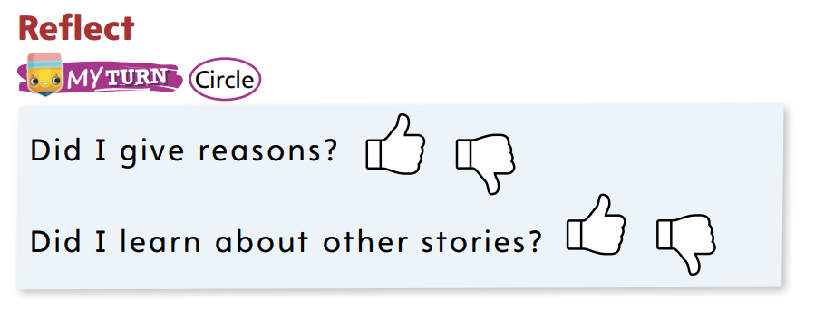
Page 226
Celebrate and Reflect
Turn to page 226 in your Student Interactive and complete the activity.
Notes:
Have students reflect on the steps they completed to do the project.
Ask questions, such as, What was the first step in your research plan? What did you do for research? What did you do at the end of the project? What did you learn about what you like about stories?
Give students time to complete the activity at the bottom of p. 226 in the Student Interactive.

Slide 40
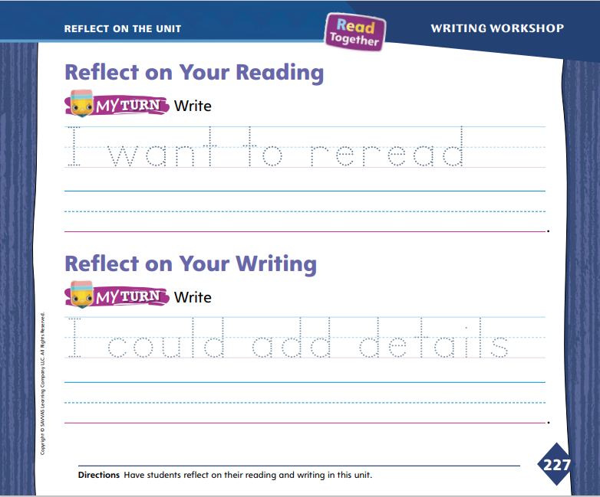
Page 227
Reflect on the Unit
Turn to page 227 in your Student Interactive and complete the activities.
Notes:
Review the Unit Goals page at the beginning of the unit. Have students reflect on their reading and writing skills. Review and discuss the Essential Question: Why do we like stories?
Display the stories from the unit. Ask volunteers to tell about each reading selection. Students’ summaries should include the text’s title and an event from the text. Ask other volunteers to offer their thoughts about which story they would like to reread and why. Offer a sentence frame, such as: I like the story _____ .
Ask students to tell about their writing. Use sentence frames, such as: I like to write _____ . I could make my writing better by _____. Have volunteers tell what they learned about writing.
Direct students to the activity on p. 227 in the Student Interactive. If needed, help them record their responses on the lines.

Slide 41
Unit 3: Week 6
Kindergarten

